Slide 1

Science Fair
By Abdul Wasaey Qasim & Zein Ionescu

Slide 2
The Problems:
Our Main Problem
Atomic energy
The use of Finite Fossil Fuels
Climate Change

Slide 3
The Problems:
Atomic Energy
Atomic energy is a type of energy that is produced from nuclear fission (atoms splitting). This is clean energy however it produces a bi-product which is its waste.
Energy too cheap to meter’ is what was said in the 1950’s about this, granted, this is affordable however the waste causes a deadly syndrome called ‘ARS’ (Acute Radiation Syndrome). This is the reason for nuclear plants being isolated, so no-one would be in proximity of it and get radiation sickness. In addition to this, many errors can occur in these power plants. This is evident from the event in Chernobyl.
To add to this, <4% of mass is converted to energy making these very ineffective. Even things such as Thorium are still ineffective despite its abundance.

Slide 4
The Problems:
Finite Fossil Fuels
Fossil fuels are non-renewable . They take a very long time to form and we are using them up faster than they can be replaced - once they have all been used up, they cannot be replaced. Fossil fuels are also finite resources . They are no longer being made or are being made extremely slow. Concerns surrounding this risk have persisted for decades. Meanwhile, actual global oil production and consumption continues to rise. However, currently due to a pandemic known as covid-19 the effects of fossil fuels have decreased. When fossil fuels are burned, they release nitrogen oxides into the atmosphere, which contribute to the formation of smog and acid rain.
As of 2019, the world's primary energy sources consisted of petroleum (34%), coal (27%), natural gas (24%), amounting to an 85% share for fossil fuels in primary energy consumption in the world. Non-fossil sources included nuclear (4.4%), hydroelectric (6.8%), and other renewables (4.0%, including geothermal, solar, tidal, wind, wood, waste). According to another source, world renewable energy-consumption was 18% in 2018. When compared with the previous year, world energy-consumption grew at a rate of 2.9%, almost double its 10-year average of 1.5% per year, and the fastest since 2010.

Slide 5
The Problems:
Climate Change
Climate Change is the increase of climate around the globe that is caused by greenhouse gases. These greenhouse gases primarily come from fossil fuels. These gases are mainly carbon gases which is why most countries are measuring their carbon footprint to monitor how much carbon they are emitting. Currently, carbon footprints are exponentially decreasing due to the Covid-19 lockdown, this was first evident in China. Climate change is also causing the rapid sea level rise due to the fact that the ice on the North and South Pole is melting. This effects many coastal countries heavily and is causing the sinking of Maldives. On a side note, many bacteria and viruses can be frozen in the ice in the North and South Pole.

Slide 6
How do we solve Climate change?
Nuclear Fusion:
This energy source is not popular amongst most countries. It has hasn’t been used much however it’s a promising energy source due to these 4 reasons:
It is sustainable, the fuels are commonly found and don’t take long to form unlike fossil fuel
It doesn’t emit CO2 so therefore its clean
Limited risk of proliferation (nuclear weapons)
No risk of meltdown (unlike like Fukushima or Chernobyl)
Currently, the cost is expensive, but this is due to the fact that this is still in testing. In half a century, the cost is envisaged to be the same as a regular fission reactor.

Slide 7
How do we solve Climate change?
The Use Of Solar Panels:
Solar power is energy from the sun that is converted into thermal or electrical energy. Solar energy is the cleanest and most abundant renewable energy source available. Today, most solar panels provide an energy efficiency rating between 11 and 15 percent, which is the percentage of solar energy that is being converted into useable electricity. Solar panel efficiency is a measurement of how much of the sun's energy a certain panel can convert into usable electricity. The highest efficiency solar panels can reach almost 23 percent efficiency. But the average efficiency of solar panels falls between the 15 to 18 percent efficiency range.
Advantages | Disadvantages
Renewable Energy Sources | Cost
Reduces Electric Bills | Weather Dependent
Diverse Application | Solar energy storage is expensive
Low Maintenance Cost | Uses a lot of space
Technology Development

Slide 8
How do we solve Climate change?
Hydroelectric power
Hydroelectric power tends to come from using pressure from water to generate kinetic energy which is then converted to heat then to electricity. There are multiple methods of achieving this. Here are some:
Dams:
This is the most common method; it uses dammed water (blocked water) to generate potential energy that will turn into kinetic energy which drives a turbine or generator. The power extracted from the water depends on the volume and on the difference in height between the source and the water's outflow.
Run of the river:
This method doesn’t use reservoirs so the water is coming is can only be used for that moment, this makes it so that excess is useless. The constant supply of water drives the turbine and generator.
Tidal:
This uses the oceans tides to create energy, these tides are easily predictable. Reservoirs will also help this. Tidal energy is inaccessible in most regions.

Slide 9
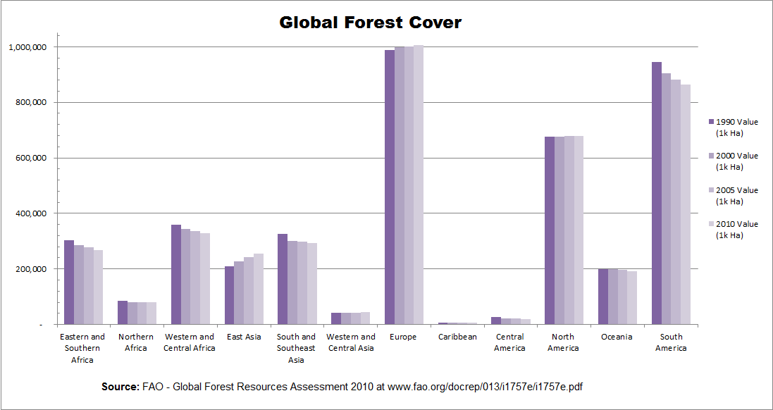
How do we solve Climate change?
Stop Deforestation:
Every year, 33 million acres of forests are cut down. Timber harvesting in the tropics alone contributes 1.5 billion metric tons of carbon to the atmosphere. That represents 20 percent of human-made greenhouse gas emissions and a source that could be avoided relatively easily. Improved agricultural practices along with paper recycling and forest management - balancing the amount of wood taken out with the amount of new trees growing - could quickly eliminate this significant chunk of emissions.
When purchasing wood products, such as furniture or flooring, buy used goods or, failing that, wood certified to have been sustainably harvested. The Amazon and other forests are not just the lungs of the earth, they may also be humanity's best short-term hope for limiting climate change.

Slide 10
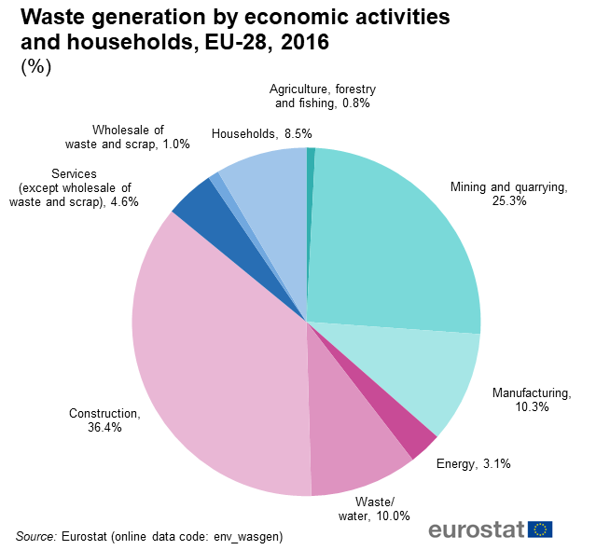
How do we solve Climate change?
Be Efficient, Don’t waste energy:
A potentially simpler and even bigger impact can be made by doing more with less. Citizens of many developed countries are profligate wasters of energy, whether by speeding in a gas-guzzling sport- utility vehicle or leaving the lights on when not in a room.
Good driving- and good car maintenance, such as making sure tires are properly inflated – can limit the amount of greenhouse gas emissions from a vehicle and, perhaps more importantly, lower the frequency of payment at the pump.
Similarly, employing more efficient refrigerators, air conditioners and other appliances, such as those rated highly for efficiency these can cut electric bills while something as simple as weatherproofing the windows of a home can reduce heating and cooling bills

Slide 11
Summary Slide:

Slide 12
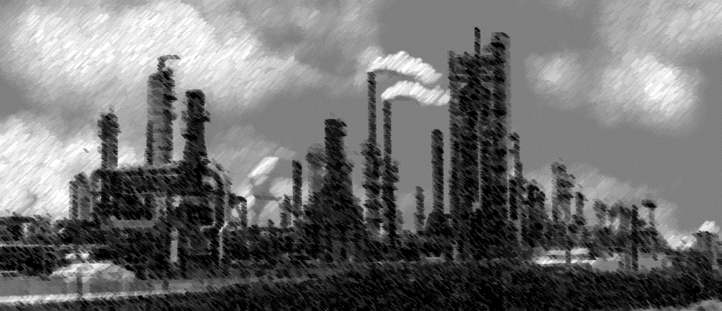
How Do We Solve Climate Change
At the end of the day we all need your help to stop climate change
Our Solutions:
We need to stop deforestation
We must be efficient with our energy
We must have clean energy sources
What Skills Did We Use?
Coordination
Conflict resolution
Decision-making
Reliability
Organizational & Planning Skills
Famous quotes:
“We have a single mission: to protect and hand on the planet to the next generation” - Francois Hollande (President of France)
“There’s one issue that will define the contours of this century more dramatically than other, and that is the urgent threat of a changing climate” – Barack Obama
( Ex-president of the USA)
“We have to wake up to the fierce urgency of the now” – Jim Yong Kim ( President, The world bank)
“The violence that exists in the human heart is also manifest in the symptoms of illness that we see in the Earth, the water, the air and in living things” – Pope Francis ( The Pope)
Summary:
The problems that we are focusing on are as follows: atomic energy, climate change and finite fossil fuels. Fission plants is a problem because it can be used for proliferation and the efficiency is terrible. Finite Fossil Fuels are a problem because we have relied on fossil fuels for a long time however they are running out. Climate change is a problem because it destroys habitats and will cause a rise in the sea level which will affect many low-lying countries such as Maldives.

